Slide 1
Making this resource work for you
Prior to teaching this lesson, please refer to the ‘Unit Overview and Planning Document’.
Further guidance on planning Science Mastery lessons can be found in the detailed planning guidance document.
Refer to the ‘notes’ section on each slide for useful information, including suggested expositions, pedagogical content knowledge, suggested questions, answers and more. Consider using presenter mode so you can see this guidance throughout the lesson.
The introduction slides can be adapted to suit your teaching style and the needs of your class.
Before the lesson, adapt the fix-it slide to address any misconceptions identified in the previous lesson’s exit ticket.
Choose from the suggested activities to suit your class. The intention is not that you complete all of these, but that you select those which ones are most appropriate for your students. It may be appropriate to further adapt activities for your students.
These lessons are designed to occupy approximately 1 hour. To adapt for a shorter or longer lesson duration we advise you to adapt the activity section accordingly.
Please consider using the final slide to send feedback about this lesson or examples of PowerPoints that you have adapted to our design team. Your feedback is used to improve Science Mastery for all of our teachers and students. We appreciate all suggestions and comments.
Thank you for reading!
The Science Mastery Team

Slide 2
Farming and Biotechnology
Answer the following questions:
Where is the producer found in a pyramid of biomass?
What is the approximate biomass efficiency transfer between each trophic level?
Why is not all biomass transferred to the next trophic level?
State the definition of an organism.
Calculate the volume of a space with the dimensions 50m, 40m and 12m.
At the bottom (the first trophic level)
Approximately 10 %
Not all material is ingested or absorbed, some biomass is lost as waste (faeces, urine, sweat etc), some is used for life processes (respiration to allow movement, growth and thermoregulation)
Any living thing e.g. plant, animal, unicellular organism
50m x 40m x 12m = 24 000m²
Notes:
Purpose: to assess learning from the previous lesson.
Foundation question: What is the term for organisms that eat producers?
Answer: Primary consumers
Stretch question: Suggest how biomass efficiency transfer could be increased.
Answer: reduce waste by using recommended daily intake of food, reduce energy loss by limiting movement and keeping temperature in the environment constant

Slide 3
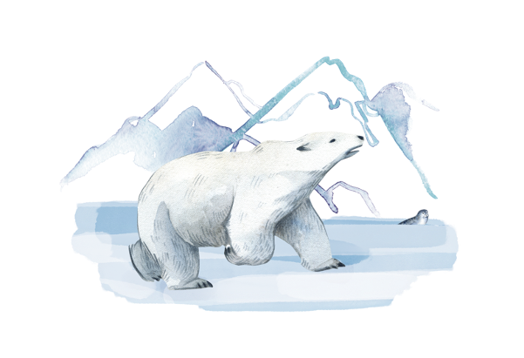
B3.2.8
12/04/2024
Taking It Further: Farming and Biotechnology
B3.2.1 Prior Knowledge Review
B3.2.2 Biodiversity
B3.2.3 How Humans Affect Biodiversity
B3.2.4 How Humans can Preserve Biodiversity
B3.2.5 The Effect of Pollution on Biodiversity
B3.2.6 Global Warming
B3.2.7 Taking It Further: Pyramids of Biomass
B3.2.8 Taking It Further: Farming and Biotechnology
B3.2.9 Taking It Further: Food Security
Notes:
Big Idea: Organisms are Interdependent
Pupils have previously learnt about biodiversity, the effects humans have on organisms around them and the efficiency of food chains. This lesson focusses on how the efficiency of food chins is taken into account during farming and how technology can be used to overcome inefficient biomass transfers.
Suggested Hook:
Did you know that 57% of land in the UK is used for agriculture? But only 5.4% of land is arable land (used for growing crops -the majority of this is cereals and grains, such as wheat). So what else is all the agriculture land used for? Mainly used as pastureland (including meadows and pastures used for rearing livestock like sheep and cows). As farming is a business, lets look at the ways that farmers maximise the money they make from rearing livestock and whether these methods are overall a good idea or not.
https://cropscience.bayer.co.uk/blog/articles/2019/10/farming-facts/

Slide 4

Following this lesson, students will be able to:
Describe methods used to maintain fish stocks
Explain how intensive farming methods increase biomass efficiency transfer
Describe an application of biotechnology in food production
Key Words:
efficiency
intensive farming
biotechnology
quota
Notes:
Can be edited depending on class need.

Slide 5
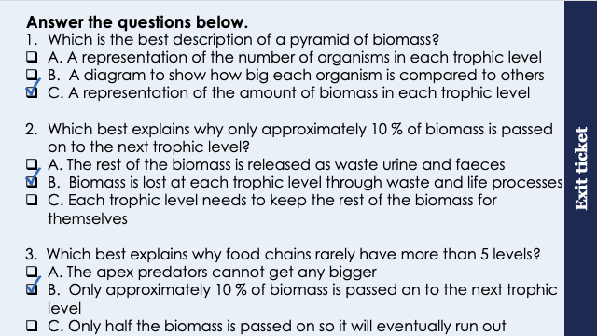
This is the fix-it portion of the lesson
The fix-it is an opportunity to respond to gaps in knowledge, especially those identified by the previous lesson’s exit ticket.
The teacher should customise this slide as needed, to facilitate
reteach, explanation, demonstration or modelling of ideas and concepts that students have not yet grasped or have misunderstood.
practise answering specific questions or of key skills.
redrafting or improving previous work.
Notes:
Purpose: to spend time on any gaps identified in previous learning from exit ticket feedback.
Suggested guidance from previous exit ticket:
Q1. Answer: C
If students answer A, they have mixed up with a pyramid of numbers. If they answer B, they have thought about individual organisms and not taken the number of organisms into account.. To fix-it, they may need a further recap of the features of a pyramid of biomass versus a pyramid of numbers. It may be useful to show an example of a large producer (e.g. a tree) which has a small representation on a pyramid of numbers but a large representation on a pyramid of biomass.
Q2. Answer: B
If students answer A or C, they are struggling with the idea that majority of biomass is used within the trophic level, either in life processes (respiration for heat and movement) or lost as waste. . To fix-it they may find it useful to practice further calculation questions (such as with missing values for respiration or waste) so that they can work out how much is wasted and how much is passed on. It may be useful to remind them of the energy efficiency = useful output/total input energy (x100) equation in physics and showing them that it is the same. For some pupils the misconception is that they will not view heat and movement as waste (because the organism in that trophic level needs them) in terms of higher trophic levels.
Q3. Answer: B
If students answer A or C, they are struggling with the idea that majority of biomass is used within the trophic level, either in life processes (respiration for heat and movement) or lost as waste. To fix-it, they may find it useful to practice further calculation questions (such as with missing values for respiration or waste) so that they can work out how much is wasted and how much is passed on. It may be useful to remind them of the energy efficiency = useful output/total input energy (x100) equation in physics and showing them that it is the same. For some pupils the misconception is that they will not view heat and movement as waste (because the organism in that trophic level needs them) in terms of higher trophic levels.

Slide 6
Intensive farming
Efficiency of biomass transfers can be improved by restricting energy transfer from food animals by using intensive farming methods.
This includes:
Limiting animals movement
Controlling the temperature of the surroundings
Feeding animals high protein diets
Issues with intensive farming:
Ethical objections
Overuse of antibiotics
Notes:
Type of exposition: explanation
Suggested Script:
As we saw last lesson, the efficiency of biomass transfers from one trophic level to another is only around 10%. This means that farmers need to feed animals an awful lot for them to grow big enough to be sold for meat (or other biomass products such as milk or eggs) which can be very expensive. This is especially a problem when consumers want to buy meat, eggs and dairy products and fish as cheaply as possible and we need to feed a rapidly growing global population.
Therefore farmers (including fish farmers) can use what are known as intensive farming methods that restrict the energy transfers of the animals and therefore increase the efficiency of biomass transfers. Thinking back to last lesson, what do you think farmers would do to animals to stop them using energy? Restrict their movement - if animals are not moving as much they are not using energy. Control or regulate their temperature, this means animals do not have to use as much energy to maintain their constant body temperature. Feed them high protein diets to increase their muscle growth.
There have been strong ethical objections to some intensive farming methods on due to animal welfare issues. Battery cages (as in the picture) were common place for hens laying eggs, often each hen had no more than the area of an A4 sheet of paper sized space to restrict movement. In 2012 laws from the EU banned battery cages for hens for welfare reasons. This does not mean hens are no longer found in cages- there are now just restrictions on the sizes of cages which can be used in the UK. The same cannot be said for the rest of the world- even in the USA in 2020 only 6/50 states had any laws around the use of battery cages in farming. Aside from the animal welfare implications, another huge disadvantage of intensive farming is the proximity of animals to each other and therefore the spread of disease. This means that many farmers use a lot of antibiotics, contributing to antibiotic resistance.
Additional information:
Top picture shows battery farmed chickens, where chickens are kept in cages to restrict movement and indoors to maintain a warm, constant temperature.
Bottom picture is a fish farm, where fish are kept in pens to control food intake and restrict movement.
Key conclusion to be drawn – animals are not wasting energy through movement or thermoregulation, meaning that the efficiency transfer is improved.
It can be interesting to have a debate on this topic with pupils as many will be horrified by these conditions and not understand that these are sources of their food. You may also want to discuss with pupils the reasons for the number of vegetarians/vegans increasing exponentially – it used to be seen as a choice based on animal welfare and the ethical implications of eating other animals, but now many more people have changed their diet to eat more sustainably.
Note - organic food is different to intensive farming and pupils do not need to know this although it could be brought up in discussion.
Image source
https://commons.wikimedia.org/wiki/File:Battery-farm.jpg
https://commons.wikimedia.org/wiki/File:Fish-farm-hero.jpg

Slide 7
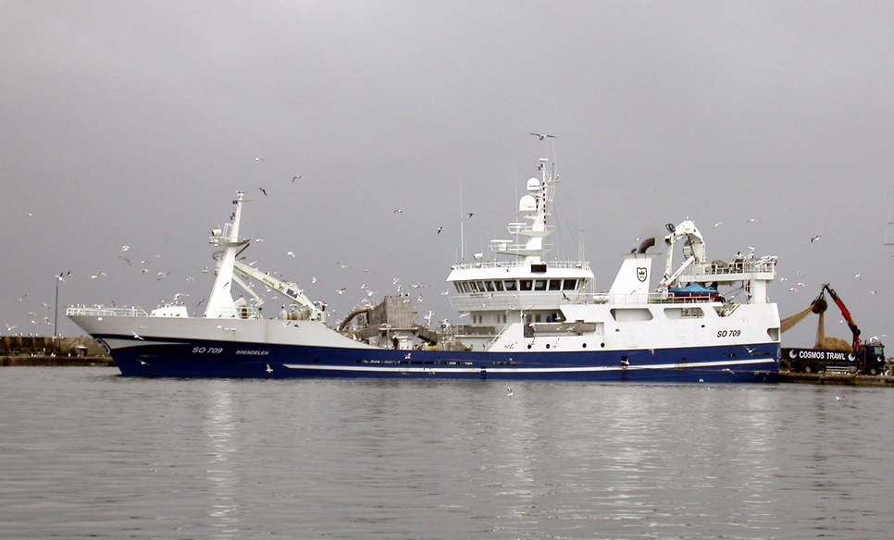
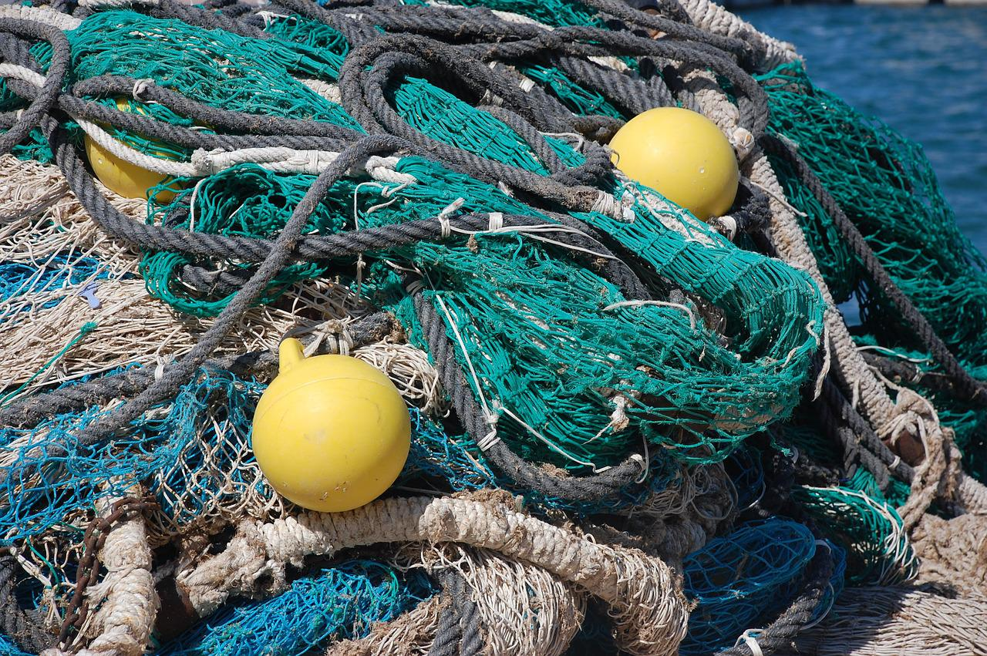
Fishing
Fish stocks in the ocean are declining
Fish populations must be sustainable otherwise species may disappear
Actions to help conserve ocean fish stocks include:
Control of net size
Fishing quotas
Notes:
Purpose: introducing new knowledge
Type of exposition: explanation
Suggested Script:
People living near water have always fished for food. However in the last 60-70 years commercial fishing has taken off where companies can catch an enormously large number of fish very quickly and regularly. This overfishing for years has caused the number of fish in the ocean to decline dramatically.
In order for fishing to be sustainable so that fish species don’t disappear, fish populations must be at a level where breeding can continue. Two actions that have been put into place to help with this are:
- Controlling net size - Net size is restricted so that not all fish are caught in every trawl (i.e. the holes in the nets need to be big enough to allow some fish to swim through – usually the juvenile fish so that they are then able to reach maturity and have their own offspring).
Fishing quotas are catch limits (usually by species), meaning there is a limit on how many of each fish species that each country can catch. These are regularly changed based on scientific guidance from the relative populations of each species –this does not mean that each country has the same quota. Quotas can be of limited use however. Once fish are caught they are often already dead meaning that if a fisherman goes over their quota they could be throwing dead fish back into the sea which is pointless. A quote does restrict the number of fishing trips though, which can be useful.
Image source
https://commons.wikimedia.org/wiki/File:Trawler_Skagen_harbour.jpg
https://pixabay.com/photos/fishing-nets-sea-water-fisherman-2820327/

Slide 8
Quick Quiz
Answer the following questions:
State two methods used to restrict energy transfer from food animals
State an advantage and a disadvantage of intensive farming methods
State two methods used to conserve fish stocks
Limiting movement, controlling the temperature of surroundings
Advantage – less energy wasted in life processes, more efficient & cost effective
Disadvantage – inhumane conditions, force feeding animals
Controlling net size and sing fishing quotas
Notes:
Purpose: review of new information.
Answer in books/MWBs. Cold call or snowball questioning to answer questions. Ensure that answers that are not completely correct are challenged.
Answers:
Limiting movement of animals and maintaining a constant temperature.
Advantage – less energy/biomass is wasted in life processes, there is a greater efficiency transfer. Disadvantage – inhumane living conditions, force feeding animals.
Controlling net size and using fishing quotas.

Slide 9

What do you think?
How much energy is passed on at each trophic level?
How would the transfer compare if chicken was cut out of this food chain?
Are intensive farming methods ethical?
What compromises could be made?
Everyone should become a vegetarian
Human
Chicken
Corn
Notes:
An opportunity for pupils to share their thoughts and opinions on quite a controversial topic that allows them to apply last lesson’s knowledge about pyramids of biomass and the knowledge from the introduction about intensive farming.
Suggested points to discuss:
ethical concerns: treatment of animals, cramped conditions, easily spread diseases
removing a trophic level means 10 % biomass passes directly to humans (rather than 10 % of 10 %)
initiatives such as ‘meat free Mondays’ etc aim to cut down rather than eliminate meat consumption
meat is available, is is the responsibility of the manufacturer or consumer to use quotas?
free range – better quality of life for animals but more energy losses (e.g. thermoregulation uses a lot more energy outside)
intensive farming methods are more cost-effective
choosing free range food is often more expensive
The following website provides a good summary of the pros and cons of the argument:
https://vegetarian.procon.org/
You may want to give these to pupils if you would like to use this talk task as a full debate.
Stretch: what is the argument for veganism?
There are lots of arguments which tend to be more animal welfare related than the sustainability argument for vegetarianism.
Suggested guidance:
Talk tasks can be used in a variety of ways to suit the particular needs of the students you are teaching. Through exchanging views with others, students develop their understanding of the science beyond what could be achieved individually.
Science classrooms that successfully integrate talk have the following features:
Science talk is a regular feature of lessons and is woven into classroom activities.
Students are paired or grouped strategically by the teacher to ensure productive interaction. This might take into consideration the students’ proficiency of the English language, how encouraging they might be to peers and their attainment in the topic. It’s a good idea to consider these pairings in the class seating plan.
Students are encouraged and supported to talk, but are not forced to talk.
The teacher should take on the role of a facilitator, engaging with conversations where necessary and encouraging or steering the conversation where needed.
Students are encouraged to use the language they have to express their ideas (e.g., everyday language, imperfect English, native language), but also to incorporate science specific terminology where this is more accurate or has been taught.
6. Scientifically inaccurate ideas are not dismissed by the partner or teacher; open discussion and further investigation are relied on to help students construct ideas that support them to progress in their scientific understanding.
7. Guidelines for behaviour during talk tasks are explicit and frequently reviewed. Rules for students might be:
Listen carefully to your partner
Take turns talking.
Speak one at a time, without interrupting.
Politely agree or disagree and explain why.
Politely point out if your partner has used a scientific word incorrectly, if they have explained the science incorrectly, or if there is a more accurate way to describe something.
If confused, ask questions.
Stay focused on the discussion topic.
Respond to one another.

Slide 10
Biotechnology
Modern biotechnology allows large quantities of microorganisms to be cultured for food
The fungus Fusarium is used to produce mycoprotein (Quorn)
The fungus is grown in aerobic conditions before the biomass is harvested and purified
Notes:
Purpose: introducing new knowledge
Type of exposition: explanation
Suggested script
All over the world scientists have been researching how to solve the problems that intensive farming and overfishing are having by developing new foods that do not come from animals. Biotechnology is when industry uses biology to make products or medicines. In this examples, biotechnology has made a food product called Quorn. A fungus called fusasium Venenatum is grown with glucose and is used to make mycoprotein which is a type of protein suitable for vegetarians
You could ask if pupils have eaten Quorn and if they know anything about it. It is grown in aerobic conditions- what does this mean? Grown in conditions that allow aerobic respiration with oxygen. Glucose + oxygen → Carbon dioxide + water. The glucose comes from glucose syrup which the fungus is grown on. Fungi grow very quickly- their biomass can double every five hours! Once the fungus has grown it is then harvested (collected) then dried and purified so the mycoprotein can be used in foods. As the fungi grow quickly and use a cheap food source- glucose this is a sustainable food source.
Suggested guidance:
Points for a possible discussion after this slide.
What nutrient does meat provide in a diet?
What nutrient does quorn provide?
What are the advantages of eating quorn? It provides fibre as well as protein, which many types of meat do not.
Are there disadvantages?
You may want to show pupils some of the legal challenges Quorn has faced in the USA, where it has to be labelled as a mould.
Image source
https://commons.wikimedia.org/wiki/File:Quorn_Spaghetti_Bolognese.jpg
https://commons.wikimedia.org/wiki/File:Quorn_Logo_2015.jpg

Slide 11
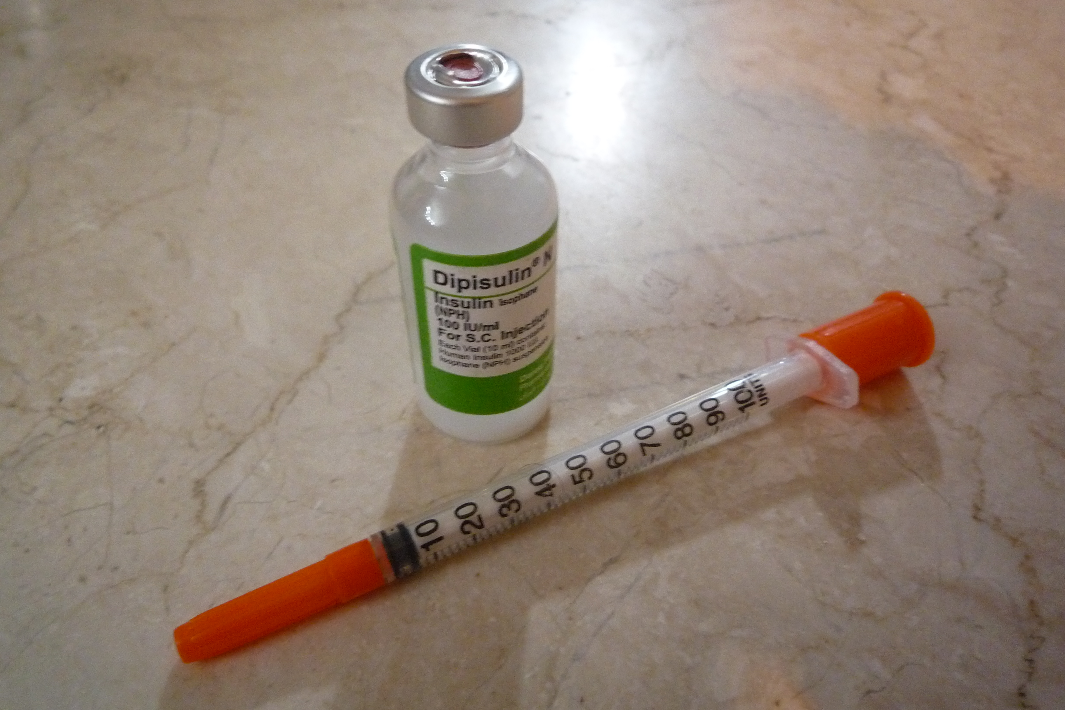
Biotechnology
Genetically modified crops can be produced that have greater nutritional value
Golden rice is a GM crop that contains beta-carotene, which is converted into Vitamin A
A genetically modified bacterium can produce human insulin, which can be used to treat people with diabetes
Notes:
Purpose: introducing new knowledge
Type of exposition: explanation
Suggested script
Another way scientists have used technology with food is by genetically modifying, also called GM, crops. This means that they have altered the DNA code of crops so that they have different, more desirable, characteristics. This could be for a number of reasons:
To increase the growth or yield of crops
To design crops that can grow in extreme conditions (eg very hot or cold parts of the world)
To engineer crops to be pesticide/herbicide resistant
To increase the nutritional value of crops
All of these improvements to crops makes farming more sustainable for our growing population.
An example of this is golden rice. There are different varieties of golden rice, the deeper the colour is the more beta-carotene it contains meaning more Vitamin A is made in the body when the rice is consumed. Golden rice is therefore grown in countries where there is a high rate of Vitamin A deficiency. It has been noted that golden rice will not solve the problem of vitamin A deficiency but will help alongside other supplements. There has been controversy with the use of golden rice - many groups of people are against the use of GM foods and argue that it is governmental control of diets.
Another way scientists have genetically modified bacteria but not for food production is to produce insulin. Insulin producing bacterium is harvested and purified before being used to treat people with diabetes.
Additional information:
Pupils should be familiar with the idea of genetic engineering and GM foods but this is not covered in great detail until B3.3.
This may be an interesting discussion around current diets and why the rate of people getting diabetes in more economically developed countries has increased massively, meaning there will need to be more insulin available to treat them.
Image source
https://commons.wikimedia.org/wiki/File:Golden_Rice.jpg
https://commons.wikimedia.org/wiki/File:Insulin%26Syringe.JPG

Slide 12
Quick Quiz
Answer the following questions:
Where does mycoprotein come from?
Why could insulin-producing bacteria be useful?
Why could Golden Rice be useful?
Fusarium fungus, grown on glucose syrup in aerobic conditions.
To provide insulin to treat people with diabetes.
To supplement Vitamin A in areas with low dietary vitamin A consumption.
Notes:
Purpose: review of new information.
Answer in books/MWBs. Cold call or snowball questioning to answer questions. Ensure that answers that are not completely correct are challenged.
Answers:
Fusarium fungus, grown on glucose syrup in aerobic conditions.
To provide insulin to treat people with diabetes.
To supplement vitamin A in areas with low dietary vitamin A consumption.

Slide 13
Drill
What is the efficiency of biomass transfer from one trophic level to another?
State two ways farmers can improve this efficiency of transfer
State two issues with intensive farming.
State two actions that have been put in place to increase the fish population
State on advantage of genetically modified crops
Notes:
Purpose: This is a knowledge drill. The purpose of this is to check that the critical knowledge is secure before pupils move onto independent practice.
Suggested guidance: There are a range of ways this could be done depending on time and ability range of the class:
Mini whiteboards
As full sentences in exercise books
As short answers in exercise books
In the pupil workbook
As pair talk
As cold call

Slide 14
Drill answers
10%
Limiting animals’ movement, controlling the temperature of the surroundings, feeding animals high protein diets
Ethical objections, overuse of antibiotics
Control of net size, fishing quotas
Crops with a greater nutritional value, can produce bacteria-producing insulin to treat diabetes
Notes:
Purpose: This is a knowledge drill. The purpose of this is to check that the critical knowledge is secure before pupils move onto independent practice.
Suggested guidance: There are a range of ways this could be done depending on time and ability range of the class:
Mini whiteboards
As full sentences in exercise books
As short answers in exercise books
In the pupil workbook
As pair talk
As cold call

Slide 15

I: Explain using scientific understanding to make something clear or state the reason for something happening
Example question:
To ‘explain’ your answer should:
Begin with a scientific statement.
Use ‘this means that’, ‘because’ or ‘so’ to link your statement to the question.
Explain why farmers make more money rearing cows for meat indoors than rearing cows outdoors.
Model answer:
Less energy wasted in movement/thermoregulation
More energy for growth
Cows grow bigger
Notes:
This slide models the process of answering an explain question.
Firstly, students are presented with a generic explain question, along with a model answer. Students are also given some simple guidance to follow for producing their own describe answer.
The generic question and answer should be used by the teacher to remind students of
the key features of a great answer
how to structure their answer
why the model answer is a good example
Following this, students will be required to apply this process to answer their own explain question, which will appear in place of the generic questions. This explain question will be specific to the topic students are learning about in the lesson. Give students time to write their own answer to this, ensuring that they use the guidance provided. To further scaffold this task for students, it may be appropriate to:
pair students up to write an answer together
list for students the key words you would like them to include in the answer
provide a writing frame or ‘points to include’ for students
A model answer for this question will appear. Teachers should review the model answer with students by referencing the guidance in the green box. For example ‘we can see item 1 in the guidance is to begin with a scientific statement. Notice in the model answer here we have done just that’. Or ‘item 2 in the guidance here says that we should use a linking statement in the answer. Has this been achieved in the model answer? Where can we see this?’.

Slide 16
We: Explain using scientific understanding to make something clear or state the reason for something happening
Example question:
To ‘explain’ your answer should:
Begin with a scientific statement.
Use ‘this means that’, ‘because’ or ‘so’ to link your statement to the question.
Explain why some farmers choose to rear cows outdoors even though the cows grow bigger rearing cows indoors.
Model answer:
Increased spread of disease
Increased use antibiotics
Cost of heating / lighting
Emotional stress reduces productivity
Welfare/ethical issues
Notes:
This slide models the process of answering an explain question.
Firstly, students are presented with a generic explain question, along with a model answer. Students are also given some simple guidance to follow for producing their own describe answer.
The generic question and answer should be used by the teacher to remind students of
the key features of a great answer
how to structure their answer
why the model answer is a good example
Following this, students will be required to apply this process to answer their own explain question, which will appear in place of the generic questions. This explain question will be specific to the topic students are learning about in the lesson. Give students time to write their own answer to this, ensuring that they use the guidance provided. To further scaffold this task for students, it may be appropriate to:
pair students up to write an answer together
list for students the key words you would like them to include in the answer
provide a writing frame or ‘points to include’ for students
A model answer for this question will appear. Teachers should review the model answer with students by referencing the guidance in the green box. For example ‘we can see item 1 in the guidance is to begin with a scientific statement. Notice in the model answer here we have done just that’. Or ‘item 2 in the guidance here says that we should use a linking statement in the answer. Has this been achieved in the model answer? Where can we see this?’.

Slide 17
You: Evaluate to make a conclusion based on evidence
Example question:
One farmer decided to rear cows indoors to grow bigger cows instead of rearing cows outdoors. Evaluate this decision by the farmer.
To ‘evaluate’ your answer should:
Use the information supplied and our own knowledge to consider the evidence for and against a point.
We may also be required to include a justified conclusion. This may sometimes be our opinion.
Model answer:
Pros
Less energy wasted in movement/thermoregulation
More energy for growth
Cows grow bigger
Cons
Increased spread of disease
Increased use antibiotics
Cost of heating / lighting
Emotional stress reduces productivity
Welfare/ethical issues
Justified conclusion given based given points.

Slide 18
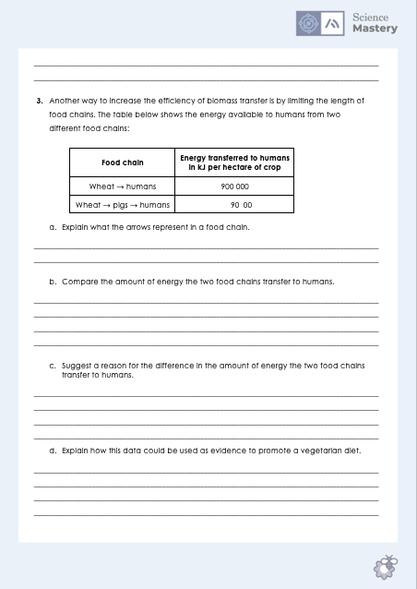
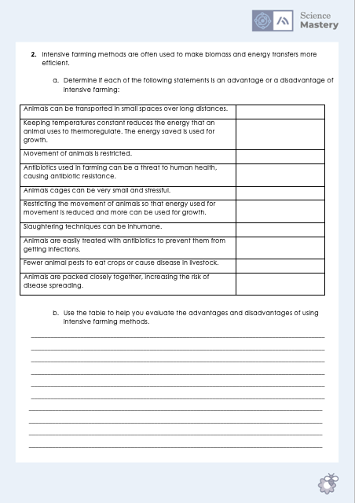
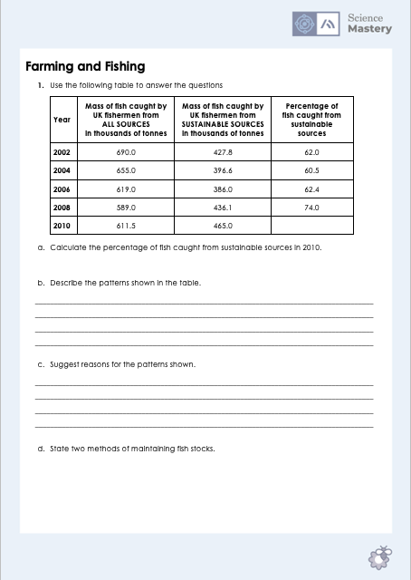
Farming and Fishing
Complete the farming and fishing worksheet
Use full sentences where necessary
Show all working for any calculations
Notes:
Purpose: application of new information.
Data adapted from past exam questions. For lower ability classes you may want to provide more structure for the evaluation question, or for higher ability classes you may want to remove the table of advantages and disadvantages.
Genetic engineering is covered in greater detail in B3.3 so this worksheet/activity focuses more on the intensive farming and fishing knowledge.

Slide 19
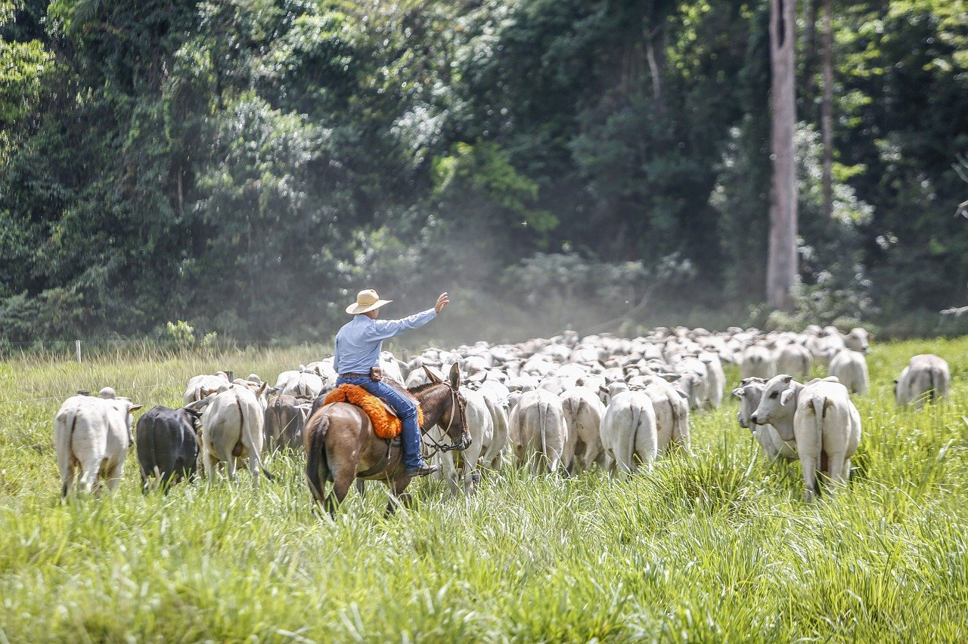
Livestock and Deforestation
80 % of deforestation in the Amazon rainforest is caused by land being converted in to grazing ground for cattle.
What does this mean for biodiversity?
What are the economic factors?
What organisms are in this food chain?
How does this link to biomass efficiency transfers?
Are the importers or exporters more responsible?
Notes:
Suggested guidance:
It is unlikely that there will be time for both activities so you may want to choose which would be more appropriate for your class.
The questions listed are suggestions, there will be lots more you may prefer to use to structure a discussion.
Picture and statistics from:
https://globalforestatlas.yale.edu/amazon/land-use/cattle-ranching
This point is highlighted in the documentary Cowspiracy.
Key outcome from this discussion is that pupils are able to link human activities with deforestation and understand how that links to their own food supply and food webs.
General teacher guidance for running a discussion:
Give specific time limits and instructions.
Limit groups to 2-3 students each. With larger groups, some students will not participate.
Allow time after the group discussions for groups to report the results of group work and for students in other groups to ask questions and comment on their peers’ ideas.
Integrate the results of group work into the closing discussion, and refer back to these ideas, when relevant, in subsequent class sessions.
Key questions for the teacher to consider:
How will you ensure that the students actively engage? There’s always a danger that the teacher ends up doing the ‘discussion’!
How can you facilitate all students contributing equally within groups, and managing both dominant and shy characters? Is it appropriate to assign ‘roles’ within groups?
How will you group students? Consider shy/dominant personalities, hard workers vs work avoiders. Opinionated students with different points of view can challenge each other – this is a good thing!
Image source
https://pixabay.com/photos/cattle-horse-field-pasture-oxen-6880115/

Slide 20
Answer the questions below.
Which is an advantage of using intensive farming methods?
A. Less energy is lost through movement and thermoregulation
B. Populations of animals must be kept very low
C. Animals can be treated with antibiotics
2. Which best explains why fishing quotas are used?
A. So that each country gets the same amount of fish
B. To make sure that not all fish are caught in each trawl
C. To maintain fish populations at a stable breeding level
3. Which is the correct description of mycoprotein?
A. Genetically modified crops with added nutritional value
B. A protein-rich food made from the fungus fusarium
C. Bacteria that are used to produce insulin
✓
✓
✓
Notes:
Q1. Answer: A
If students answer B or C, they may have not understood the purpose of intensive farming. To fix-it, go through the reasoning behind intensive farming and then they could use practice of determining more advantages and disadvantages of intensive farming methods (similar to Q2 on the worksheet for this lesson).
Q2. Answer: C
If students got Q2 wrong they have not understood the difference between fishing quotas and restricting net size, quotas are used to ensure that each country gets a fair supply but the reason for this is that populations have to remain at a level where breeding can happen. To fix-it, it may be useful to show examples of different types of quota (such as whale quotas in Scandinavian countries).
Q3. Answer: B
If students answer A or C, they need to practice identifying the different applications of biotechnology – this is covered in greater detail in B3.3. To fix-it, in this incidence break down the word mycoprotein. Myco means fungus and then protein hence protein grown from a fungus.

Slide 21
Lesson B3.2.8
What was good about this lesson? | What can we do to improve this lesson?
Send us your feedback by clicking this link
or by emailing sciencemastery@arkonline.org
Thank you!

